Slide 1

THE CYBER PERIPHERY
Cyber norms, Internet Governance and inequalities
Bernardo Beiriz - ICANN NextGen

Slide 2
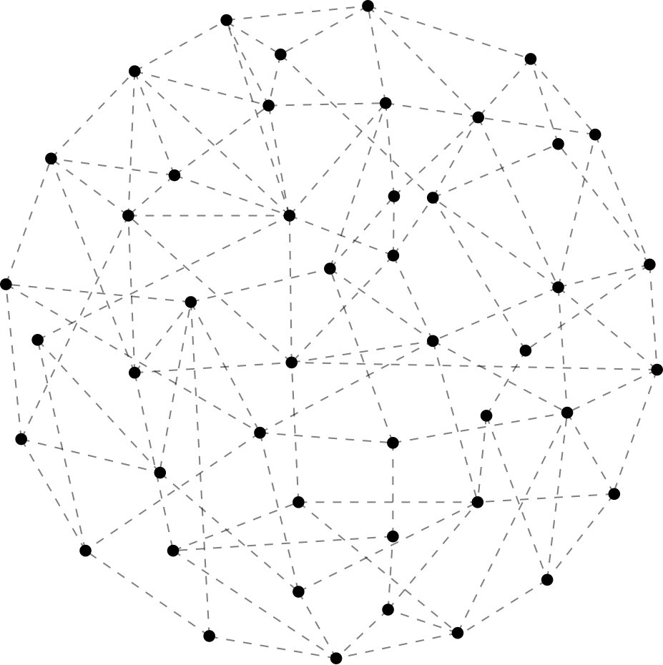

FROM WORLD-SYSTEM THEORY TO INTERNET GOVERNANCE
In the "world-system", the core and the periphery would engage in a relationship that resulted in the development of the core and underdevelopment for the periphery (Frank 1968)
The Digital Divide as a first way of translating the core-periphery division to cyberspace: access and expertise related to Information and Communication Technologies (ICTs)
Geopolitics and power relations as another way of understanding the core-periphery model: the two centers of Internet Governance

Slide 3
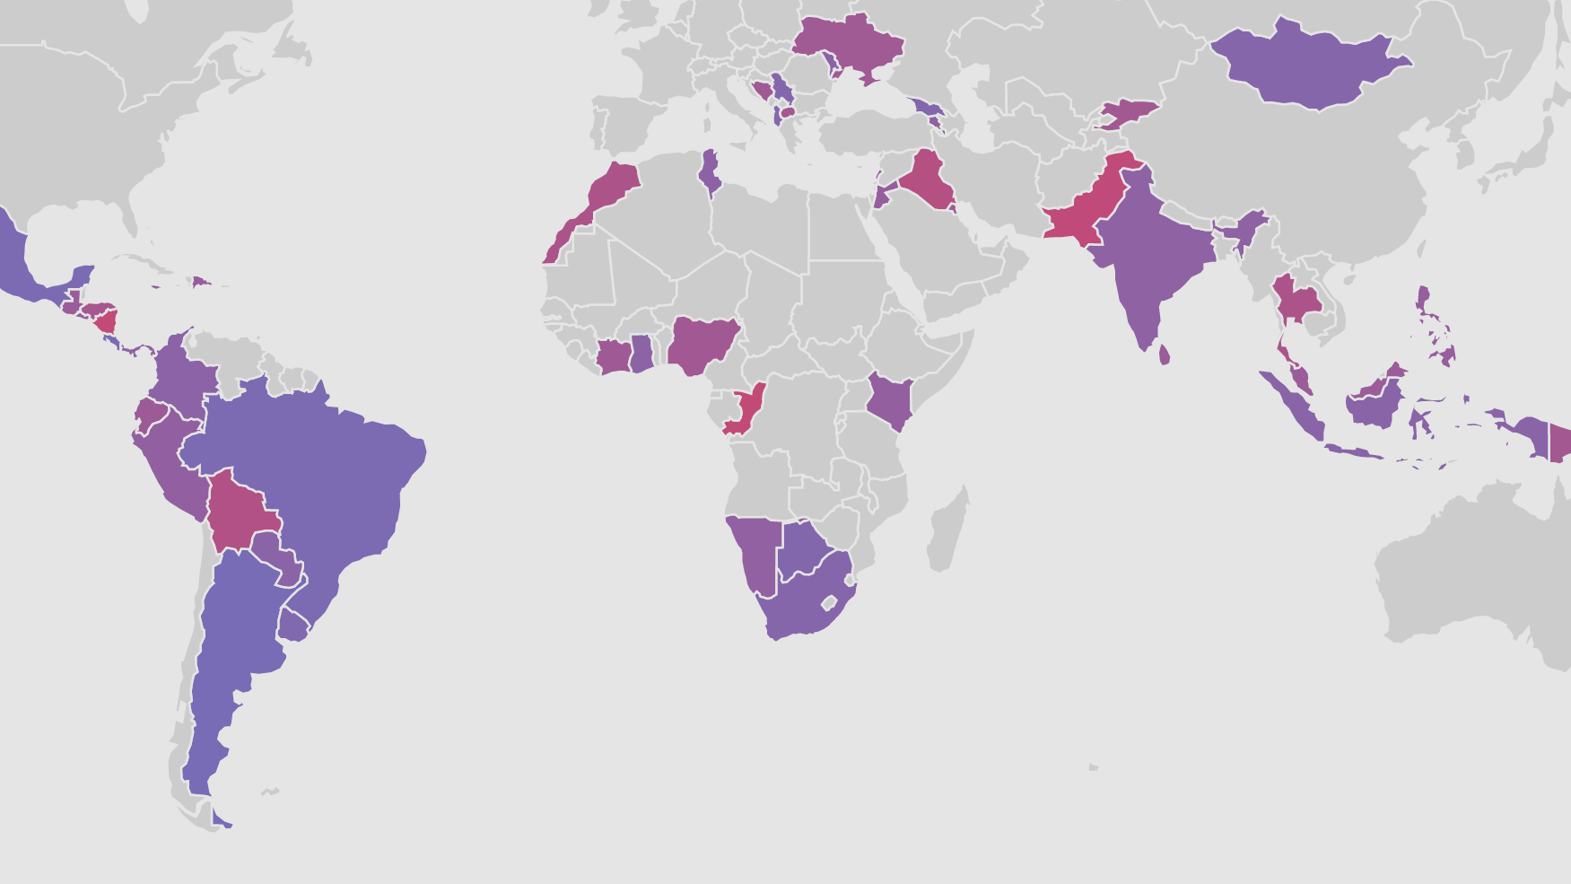
MUCH MORE THAN "TWO CENTERS" IN INTERNET GOVERNANCE
Source: The Digital Deciders (2018) by Morgus, Woolbright and Sherman

Slide 4

Internet Governance
Inequalities
Internet Governance does not take place in a "vacuum": therefore it cannot be separated from the inequalities that exist in the International System

Slide 5

CYBER NORMS
How is this division between "cyber core" and "cyber periphery" influencing the development of cyber norms?
As Finnemore and Hollis (2016) put it, "the history of the Internet is rife with examples of cyber norms that appeared out of habit"
"Generative or constitutive norms create new actors and new institutions like the Internet Corporation for Assigned Names and Numbers (ICANN)"

Slide 6
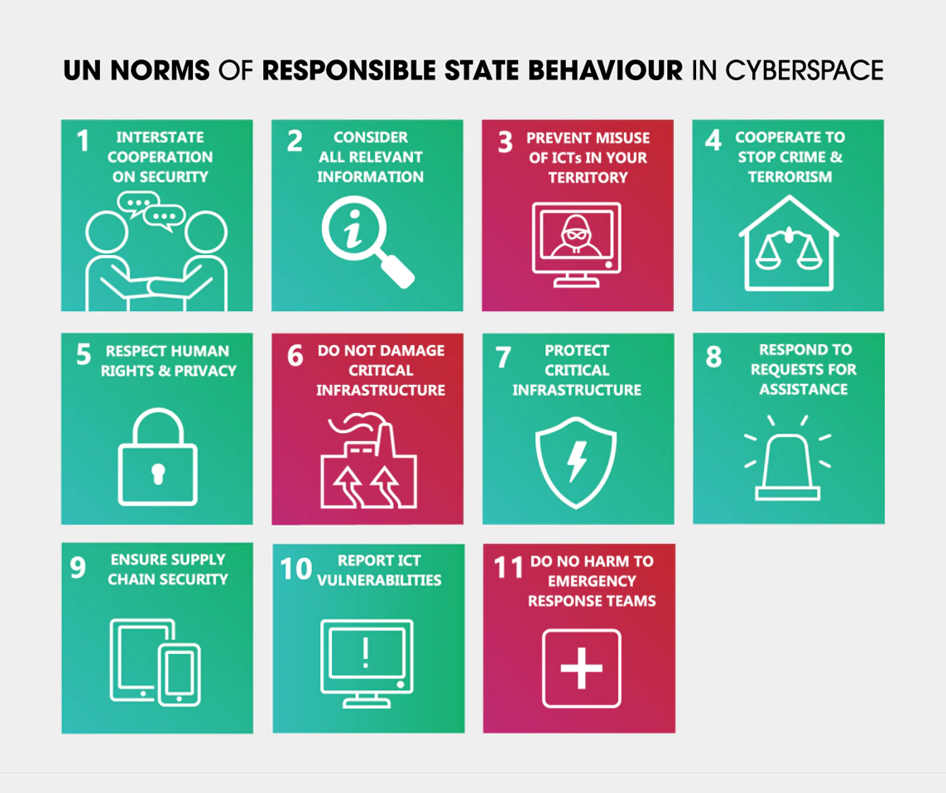
Source: Australian Strategic Policy Institute, ASPI

Slide 7
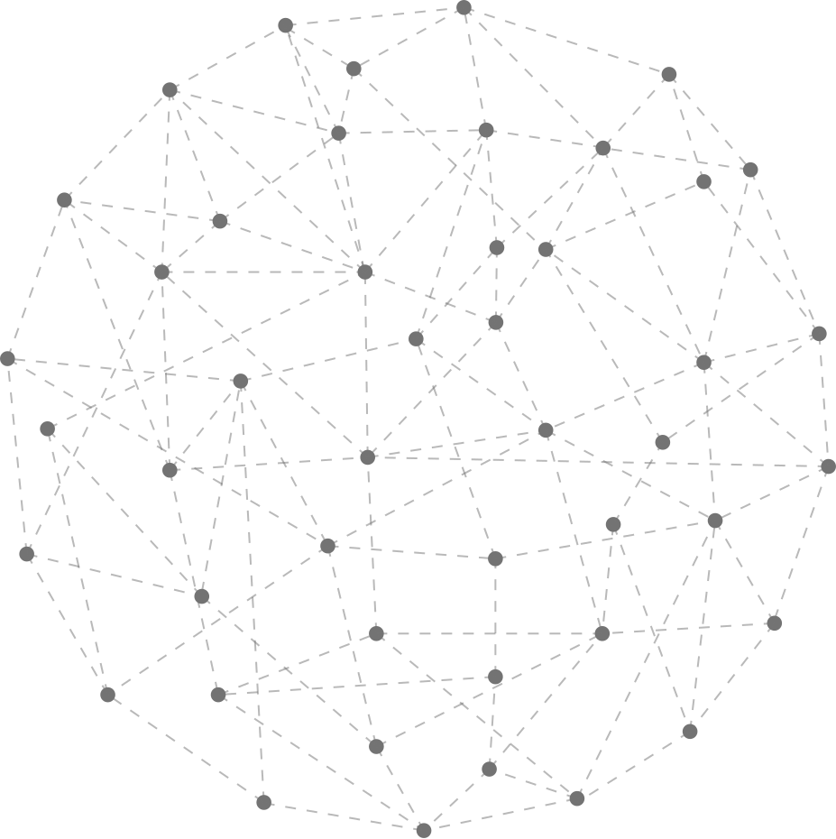
WHY STUDY THE CYBER PERIPHERY THROUGH NORMS?
It is necessary to "analyze the contexts and processes in which these norms are produced and agreed upon" (Finnemore and Hollis 2016)
Analyzing norms building processes allow us to look at the power relations between actors and institutions, unveiling hidden dynamics of inequality
Notes:
As Roxana Radu argues, “grasping who has the means and the capacity to stimulate, promote and sustain normative change, and under what conditions this process takes place, is central to taking forward debates on governance reform in the digital environment” (Radu, 2021)

Slide 8
CONCLUSION AND NEXT STEPS
Illustrates how debates in Internet Governance are shaped by power structures that can be traced back to the world-system division between core and periphery
THE CYBER PERIPHERY
Provides a new framework for looking at the relationships between Internet Governance and Inequality
To do: develop concrete analysis of where and how this division between core and periphery appear in Internet Governance debates

Slide 9
THANK YOU.
bernardobeiriz@gmail.com
Twitter: @bernardobeiriz
bernardobeiriz.com

